Slide 1
Class 16
March 5, 2020

Slide 2
Risk Communications
When the public is angry or frightened, and
They don’t trust the messenger
Special communications techniques are required
Often called “risk communications.”

Slide 3
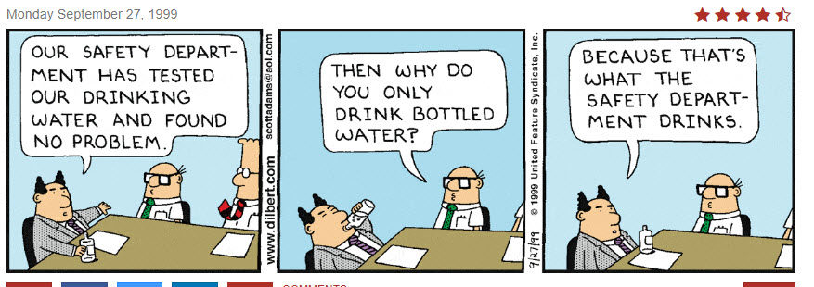

Slide 4
Risk = Hazard + Outrage
(Sandman’s nomenclature)
Risk, the danger the public perceives
Hazard, the danger you compute
Outrage?

Slide 5
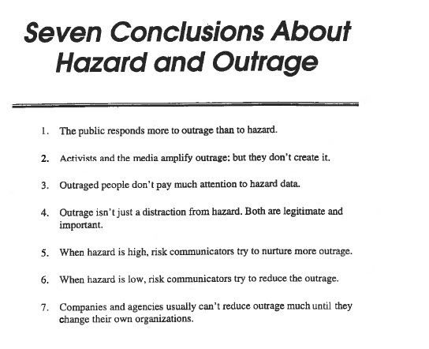
Sandman’s Outrage

Slide 6
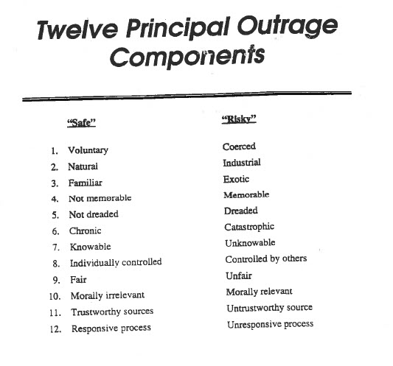

Slide 7
Take Home Ideas
When dealing with the public, what they are upset about may not relate to your computations.
Do not try to explain to the public why they are wrong.
Try to determine the source of their outrage
Work on the outrage, not your computations
Examples

